Slide 1


Group 6
&
1801CS30 - Kunj Taneja
1801CS31 - M. Maheeth Reddy
1801CS32 - M. Nitesh Reddy

Slide 2

HYPERLEDGER CACTUS
RECAP
It is a protocol that aims to solve the fragmentation problem or at least aims to solve it with the help of heterogeneous system architecture.
It is a Blockchain Integration Framework
It aims to provide Decentralized, Secure and Adaptable Integration between Blockchain Networks.
It includes a set of libraries, data models, and SDK to accelerate development of an integrated services application.
Notes:
This is a quick recap about Hyperledger Cactus:
It is an open-source project that aims to provide a decentralized, adaptable and secure integration between blockchain networks.
It was initially proposed under the name Blockchain Integration Framework and allows users to transact on multiple distributed ledgers without introducing yet another competing blockchain.
It offers a protocol to solve fragmentation and interoperability between heterogeneous system architecture.
It consists of:
Ledger Plugins – they provide the mechanism to communicate with various DLT platforms (Hyperledger Fabric, Corda, Go-Ethereum, Corda OS, Hyperledger Besu, Quorum, Hyperledger Sawtooth)
Business Logic Plugin samples – these plugin samples help the application integrate multiple blockchains
Various Support Libraries – these are utility libraries that make programming business logic plugins easy.
These modules accelerate the development of an integrated services application

Slide 3
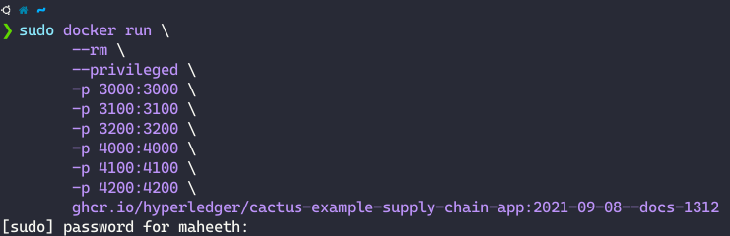
Download & Install
Ensure a working installation of Docker is present on your machine.
Run the following command to pull up the container that will run the example application and the test ledgers as well:
Notes:
To install Hyperledger Cactus, we need to
Ensure that Docker is installed and working on our computer.
Then we will run this docker command in the screenshot. This command will automatically download the Hyperledger Cactus Docker Container and also initiates the localhost server

Slide 4
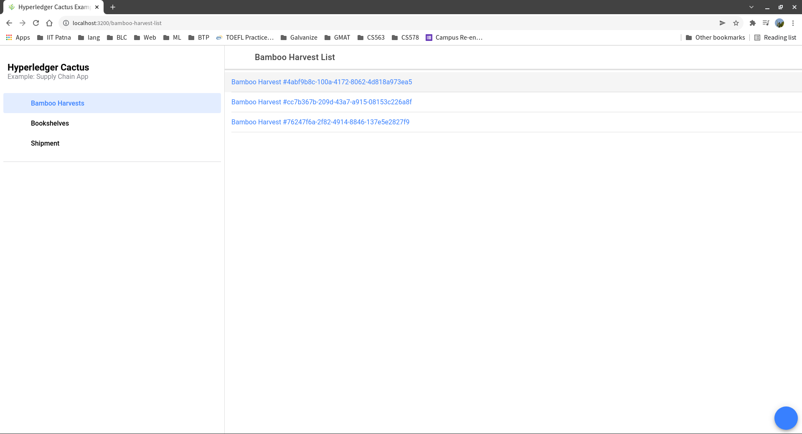
Download & Install
Wait for the output to show the message
Visit http://localhost:3200 in a web browser with Javascript enabled
Screenshot Cactus
Notes:
After running the docker run command, we have to wait until this message “Cactus Cockpit reachable” is shown.
Once that message has appeared, open the link printed on the console with a web browser of your choice.

Slide 5
Use Case: Supply Chain
Notes:
Now, I will be talking about a Use Case of Hyperledger Cactus in the domain of Supply Chain

Slide 6
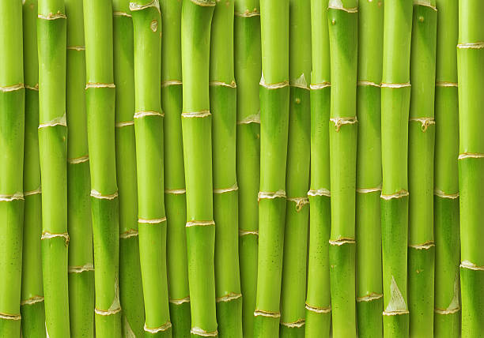

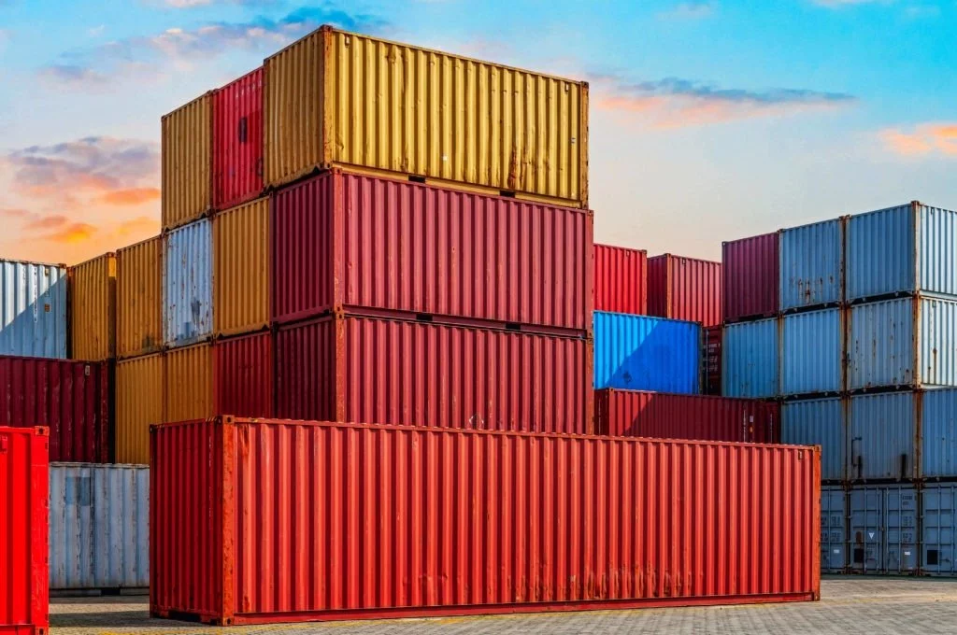
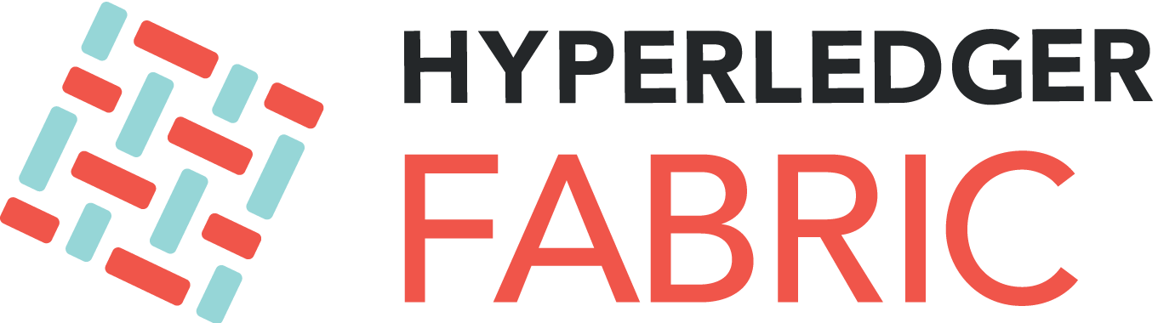

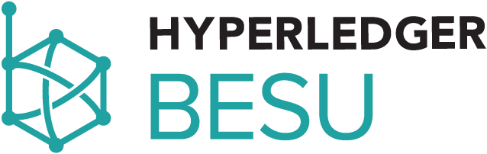
Scenario
Bamboo Harvest
ID
Location
Started at
Ended at Harvester
Bookshelf
ID
Harvest ID
Shelf Count
Shipment
ID
Bookshelf ID
Notes:
Here is a Paper Supply Chain ecosystem. There are three different entities: Bamboo Harvester, Bookshelf manufacturer and Shipment manager. They are running their blockchains Hyperledger Besu, Quorum and Fabric blockchains respectively. Even though each of them are connected exclusively to their own blockchain, they can interact with each other through Hyperledger Cactus.
As mentioned before, Hyperledger Cactus allows interoperability between different blockchain platforms. These entities utilizing different blockchain platforms will use Cactus to share the necessary data from one network to another by keeping the information intact. This way data can be shared among different systems without the need to create custom solutions for each type of infrastructure out there.
Now, we will use the Cactus GUI to create data on each ledger and observe that a consistent view of the data from different ledgers is provided.

Slide 7
SHOW TIME

Slide 8

Hyperledger Cactus Demo

Slide 9
HYPERLEDGER EXPLORER
RECAP
A user-friendly Web application tool used to view or invoke transactions, digital wallets, and other information stored in a Hyperledger blockchain deployment.
Provides a GUI that allows users to view the necessary network information of the blockchain.
Been in existence since the inception of the Hyperledger project in 2016.
Being used and contributed to by more than 130 organizations, under the Linux Foundation.
Only supports Hyperledger Fabric.
Notes:
This is a quick recap about Hyperledger Explorer. It is a simple, powerful, easy-to-use, open source Web application tool to browse activity on the underlying blockchain network.
It allows users to view, invoke, deploy, or query:
blocks
transactions and associated data
network information
chaincodes
transaction families
any other relevant information stored in the ledger
Hyperledger Explorer attempts to provide an easy visualization by using graphs, charts, pictures, and templates, in addition to the usual search and monitoring facility. We will talk about these visualizations in our next presentation.
It has been in existence ever since the Hyperledger project was started in 2016.
As of now it only supports Hyperledger Fabric at the production level.

Slide 10

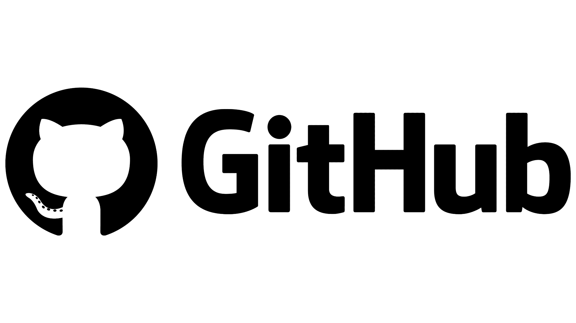
Methods to Install
Notes:
We can install Hyperledger Explorer in 2 ways:
We can use the Docker container provided by Hyperledger, or
We could also use the codebase provided in the project’s github page.
We are using Docker is an easier because all dependencies are pre-installed and we don’t have go through the task of cloning the huge github repo, setting up the PostgreSQL database and building the whole codebase.

Slide 11
Pre-requisites
Docker
https://docs.docker.com/engine/install/ubuntu/
Docker Compose
sudo apt-get -y install docker-compose
Hyperledger Fabric Network
Official Tutorial
https://hyperledger-fabric.readthedocs.io/en/latest/test_network.html
Notes:
For running the docker containers, we need to install Docker and Docker Compose. We should also get a Hyperledger Fabric Network up and running. After all, the Explorer’s function is to show the nodes, blocks, transactions info of the connected Fabric network. So, having a Fabric network is essential. We have also provided the links to the tutorials and commands for installing each one of these prerequisites. Also the setup of fabric network has been explained by another group today.

Slide 12
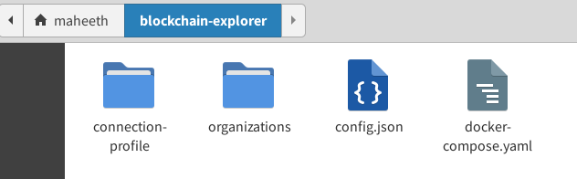
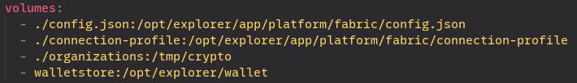
Configure
1. Copy the following files from repository:
docker-compose.yaml
wget https://raw.githubusercontent.com/hyperledger/blockchain-explorer/main/examples/net1/config.json
examples/net1/connection-profile/test-network.json
wget https://raw.githubusercontent.com/hyperledger/blockchain-explorer/main/examples/net1/connection-profile/test-network.json -P connection-profile
examples/net1/config.json
wget https://raw.githubusercontent.com/hyperledger/blockchain-explorer/main/docker-compose.yaml
2. Provide network name and path to volumes to be mounted on Explorer container (docker-compose.yaml) to align with your environment
Notes:
After installing the prerequisites, we need to fetch some configuration files from the Explorer’s Github Repository and edit them. So, here are the files:
docker-composer consists of the name of the fabric network the explorer container has to connect to. It also has paths to the connection profiles of the fabric network.
test-network consists of the admin credentials and also the information of the nodes, which are referred as peers in hyperledger terms, present in the fabric network
config consists of the test network information
You can download all these into a directory as shown in the screenshot here using the commands we have written here
We had set up a hyperledger fabric network in the prerequisites section. So, now we will copy two configuration folders of the fabric network into the explorer’s files.

Slide 13
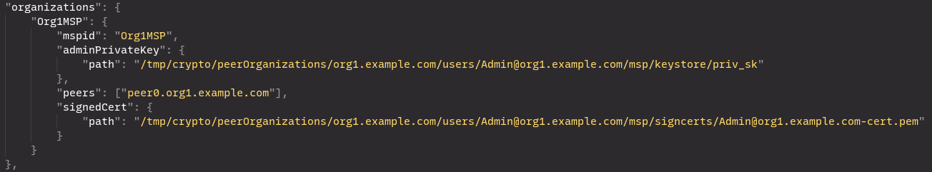
Configure
3. Edit path to admin certificate and secret (private) key in the connection profile (test-network.json). You need to specify with the absolute path on Explorer container.
4. Copy entire crypto artifact directory (e.g. crypto-config/, organizations/) from your fabric network
Notes:
After installing the prerequisites, we need to fetch some configuration files from the Explorer’s Github Repository and edit them. So, here are the files:
docker-composer consists of the name of the fabric network the explorer container has to connect to. It also has paths to the connection profiles of the fabric network.
test-network consists of the admin credentials and also the information of the nodes, which are referred as peers in hyperledger terms, present in the fabric network
config consists of the test network information
You can download all these into a directory as shown in the screenshot here using the commands we have written here
We had set up a hyperledger fabric network in the prerequisites section. So, now we will copy two configuration folders of the fabric network into the explorer’s files.

Slide 14
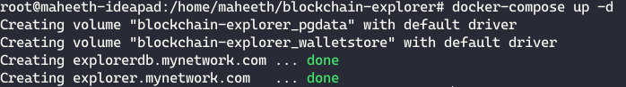
Running Explorer
Run the following command to start the Explorer docker container:
Now, we can access Hyperledger Explorer at http://localhost:8080/
Notes:
After configuring the explorer’s docker container, we will now take a look at the explorer. We will start it’s docker container by running the command: docker-compose up -d
Then, we will be able access the explorer’s GUI at 8080 port of localhost.

Slide 15
Use Case: Asset Transfer

Slide 16


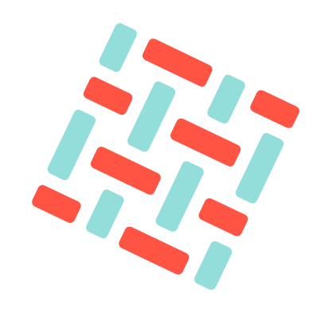
Scenario
Sriram | Shiva | Mahesh | Nitesh | Kunj | Maheeth
Asset Transfer
Viewed in Explorer
Stored in Fabric
Sita

Slide 17
SHOW TIME

Slide 18
Hyperledger Explorer Demo

Slide 19
About Smart Contracts
They are Tools and not blockchains like Hyperledger Fabric, Ethereum etc.
So, there are no Smart Contracts for Cactus and Explorer.
This is the reason, we cannot explain about Smart Contracts for Cactus and Explorer.
This slide is present because sir suggested us to mention this during the presentation.

Slide 20


